Slide 1
Song Popularity
IOD Cohort Feb 2025
Mini Project 1 Presentation
Francesca Felizardo
May 7, 2025

Slide 2
Agenda
Background – Rationale, Source, Data Scope
Methodology Overview
Problem Statement
Exploratory Data Analysis
Modelling - Regression
Insights Summary and Future Work

Slide 3
Background
Music has been an integral part of human culture for centuries, influencing our overall wellbeing.
Some songs tend to resonate more strongly with listeners than others which has led to various studies aiming to uncover the factors that drive a song's popularity.
The main objective of this project is to identify which of these features most significantly influence and best predict a song’s potential popularity.

Slide 4
Methodology Overview
Define
Scope and Objective
Prepare
Data wrangling, cleaning and profiling
Analyse
Exploratory Data Analysis
Deliver
Ridge Regression
Feature Selection
Business Questions
Understand dataset source and scope
Score (Rsquared)
Model deployment

Slide 5
Data Source and Project Scope
Dataset Source
Kaggle Dataset
Collected 3 years ago from Spotify using their API
Consists of different songs, their popularity score and several of their audio features
Popularity score was based on the number of times a song was streamed / played
Project Scope
Initial focus of the project is understanding which features drive a song’s popularity
Modelling is limited to the use of Regression techniques to predict a song’s popularity

Slide 6
Problem Statement
Business Questions
What makes a song popular on streaming platforms?
Can we predict how popular a song will be based on its sound characteristics?
Data Questions
Which sound features are most correlated with song popularity?
Which sound features drive popularity, and can we use them in a predictive model?

Slide 7
Exploratory Data Analysis
Post Data Wrangling and Cleaning
Dataset has 14,926 unique songs defined by their 13 sound features and a popularity score
Song Popularity Score
Song Duration
Energy
Loudness
Key
Acousticness
Instrumentalness
Speechiness
Audio Mode
Danceability
Liveness
Tempo
Time Signature
Audio Valence
Categorical
Numeric
Notes:
song_popularity - song popularity score based on number of plays / streams of a song
key - The key the track is in. Integers map to pitches using standard Pitch Class notation. E.g. 0 = C, 1 = C♯/D♭, 2 = D, and so on. If no key was detected, the value is -1. >= -1; <= 11
audio_mode - Mode indicates the modality (major or minor) of a track, the type of scale from which its melodic content is derived. Major is represented by 1 and minor is 0.
time_signature - An estimated time signature. The time signature (meter) is a notational convention to specify how many beats are in each bar (or measure). The time signature ranges from 3 to 7 indicating time signatures of "3/4", to "7/4".
song_duration_ms - The duration of the track in milliseconds.
energy - Energy is a measure from 0.0 to 1.0 and represents a perceptual measure of intensity and activity. Typically, energetic tracks feel fast, loud, and noisy. For example, death metal has high energy, while a Bach prelude scores low on the scale. Perceptual features contributing to this attribute include dynamic range, perceived loudness, timbre, onset rate, and general entropy
loudness - The overall loudness of a track in decibels (dB). Loudness values are averaged across the entire track and are useful for comparing relative loudness of tracks. Loudness is the quality of a sound that is the primary psychological correlate of physical strength (amplitude). Values typically range between -60 and 0 db.
acousticness - A confidence measure from 0.0 to 1.0 of whether the track is acoustic. 1.0 represents high confidence the track is acoustic.
instrumentalness - Predicts whether a track contains no vocals. "Ooh" and "aah" sounds are treated as instrumental in this context. Rap or spoken word tracks are clearly "vocal". The closer the instrumentalness value is to 1.0, the greater likelihood the track contains no vocal content. Values above 0.5 are intended to represent instrumental tracks, but confidence is higher as the value approaches 1.0.
speechiness - Speechiness detects the presence of spoken words in a track. The more exclusively speech-like the recording (e.g. talk show, audio book, poetry), the closer to 1.0 the attribute value. Values above 0.66 describe tracks that are probably made entirely of spoken words. Values between 0.33 and 0.66 describe tracks that may contain both music and speech, either in sections or layered, including such cases as rap music. Values below 0.33 most likely represent music and other non-speech-like tracks.
danceability - Describes how suitable a track is for dancing based on a combination of musical elements including tempo, rhythm stability, beat strength, and overall regularity. A value of 0.0 is least danceable and 1.0 is most danceable.
liveness - Detects the presence of an audience in the recording. Higher liveness values represent an increased probability that the track was performed live. A value above 0.8 provides strong likelihood that the track is live.
tempo - The overall estimated tempo of a track in beats per minute (BPM). In musical terminology, tempo is the speed or pace of a given piece and derives directly from the average beat duration.
audio_valence - A measure from 0.0 to 1.0 describing the musical positiveness conveyed by a track. Tracks with high valence sound more positive (e.g. happy, cheerful, euphoric), while tracks with low valence sound more negative (e.g. sad, depressed, angry).

Slide 8
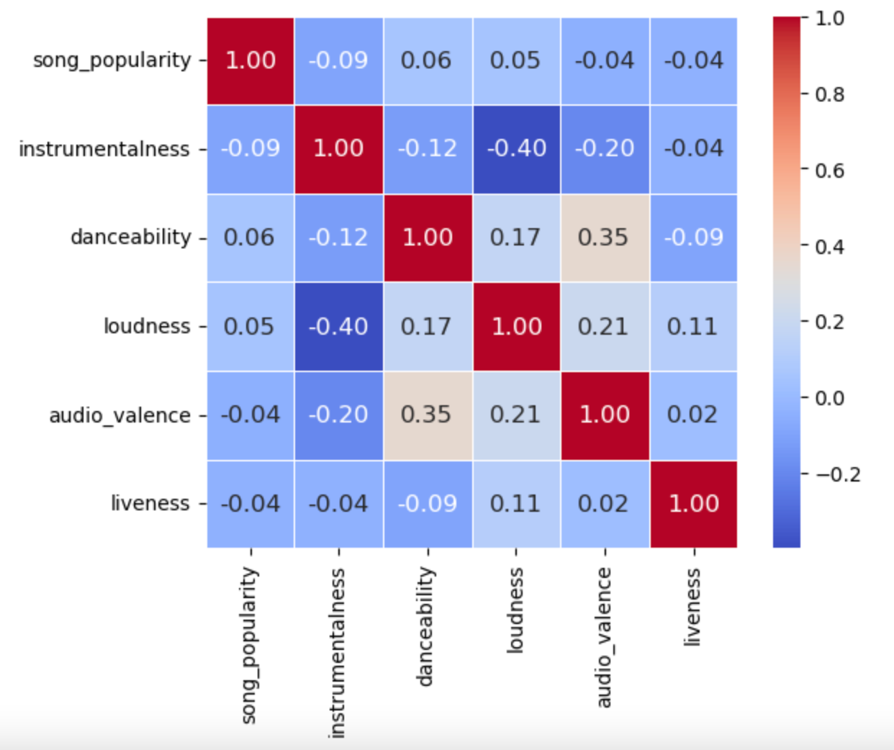
Exploratory Data Analysis
Correlation to Song Popularity
Sound features which most significantly drive song popularity
The sound features we have on the dataset have low correlation with song popularity
Instrumentalness and Loudness looks to be moderately negatively correlated to each other
Amongst the sound features we have, Instrumentalness is by far the most significant feature which could potentially predict a song’s popularity

Slide 9
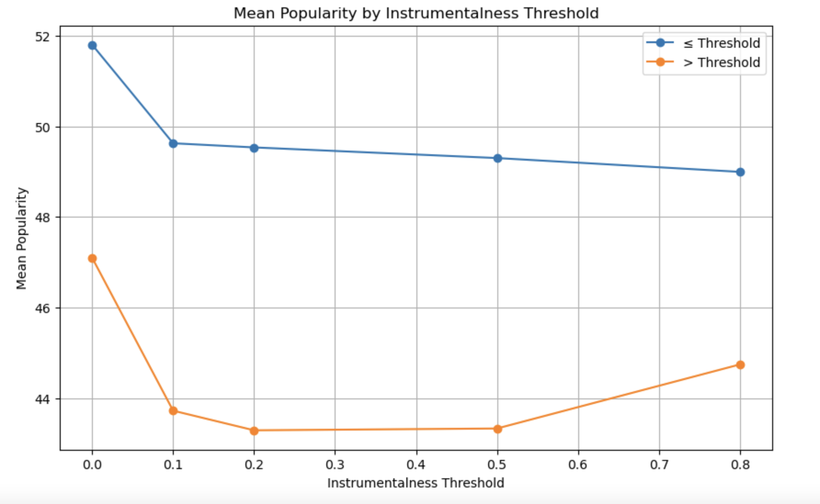
Exploratory Data Analysis
Deep Diving on Most Significant Sound Feature -- Instrumentalness (through Hypothesis Testing)
Does the mean popularity score change with a change in value of Instrumentalness? – YES!
Statistically significant evidence that the popularity of songs changes depending on whether their instrumentalness is above or below each threshold
Distribution and mean popularity differ significantly between "low" and "high" instrumentalness groups
More vocals = higher popularity score

Slide 10
Predicting Song Popularity
Given that the features we have on the data have low correlation to song popularity, expectation of accurately modelling popularity score with the sound features we have on hand is low
Modelling through Linear Regression
Best Model found is through Ridge Regression
Best Features to predict are a combination of features like Instrumentalness , Danceability, Loudness, Liveness, Tempo, Audio Valence and Acousticness
R-squared : 0.0163 – model can only explain 1.63% variance on popularity score
Weak or no linear relationship

Slide 11
Summary
Insights
Further Work and Discovery
Current data on sound features cannot accurately predict song popularity due to their low correlation and thus are weak predictors of a song’s popularity score
Instrumentalness feature however is the most significant to song popularity in our dataset with the mean popularity score changing between low and high instrumentalness value
Linear regression is potentially not the best model to describe the relationships between the data
Consider acquiring and exploring more data and more sound features as there might be other significant missing predictors of popularity
Explore modelling and predicting through non- linear modelling algorithms

Slide 12
Thank you!

